Slide 1
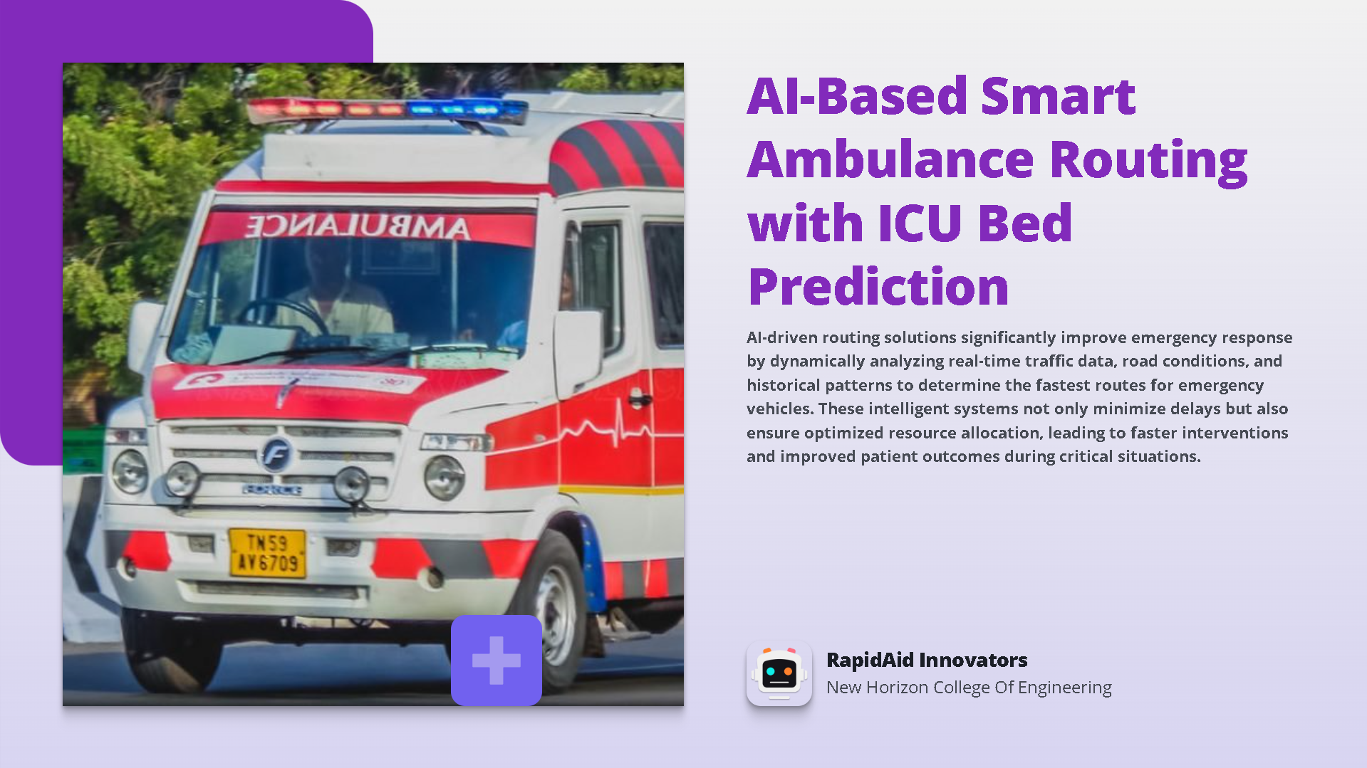

Slide 2
Challenges in Emergency Medical Services
Key Issues Affecting Effectiveness
Delayed Response Times
Traffic congestion leads to ambulance response times exceeding 20 minutes in major cities, worsening patient outcomes.
01
Finding Available ICU Beds
Difficulty in locating hospitals with available ICU Beds during emergencies can delay critical care.
02
03
04
Co-ordination Issues
Lack of real-time communication between ambulances and hospitals complicates patient transfer and treatment.
Impact of Delays
Delays in treatment directly correlate with increased mortality rates, emphasizing the need for efficient solutions.

Slide 3
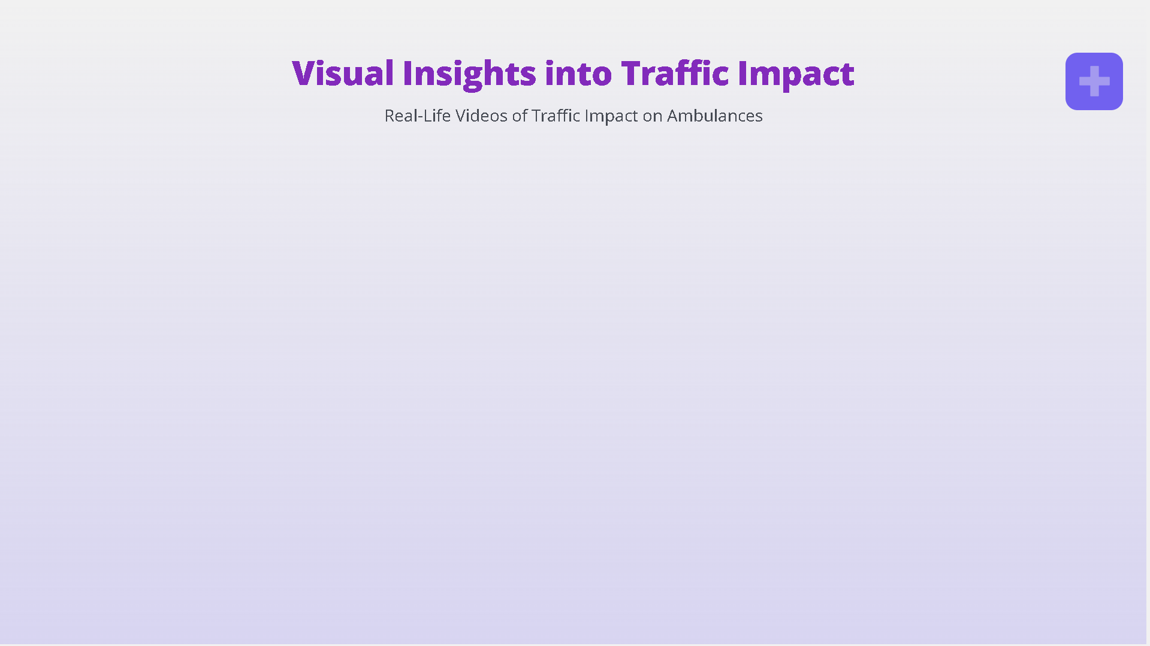


Bengaluru, India
Chalakudy, Kerala

Slide 4
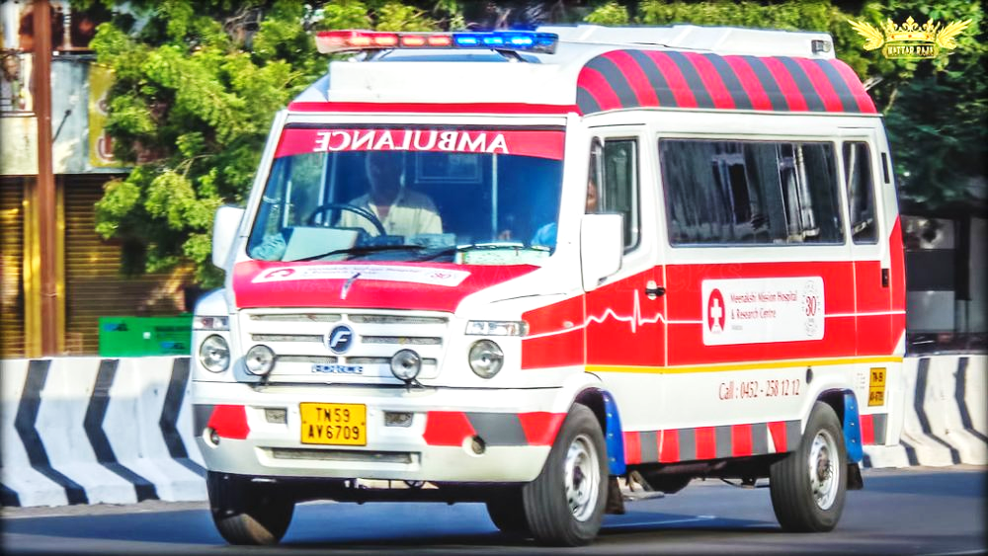

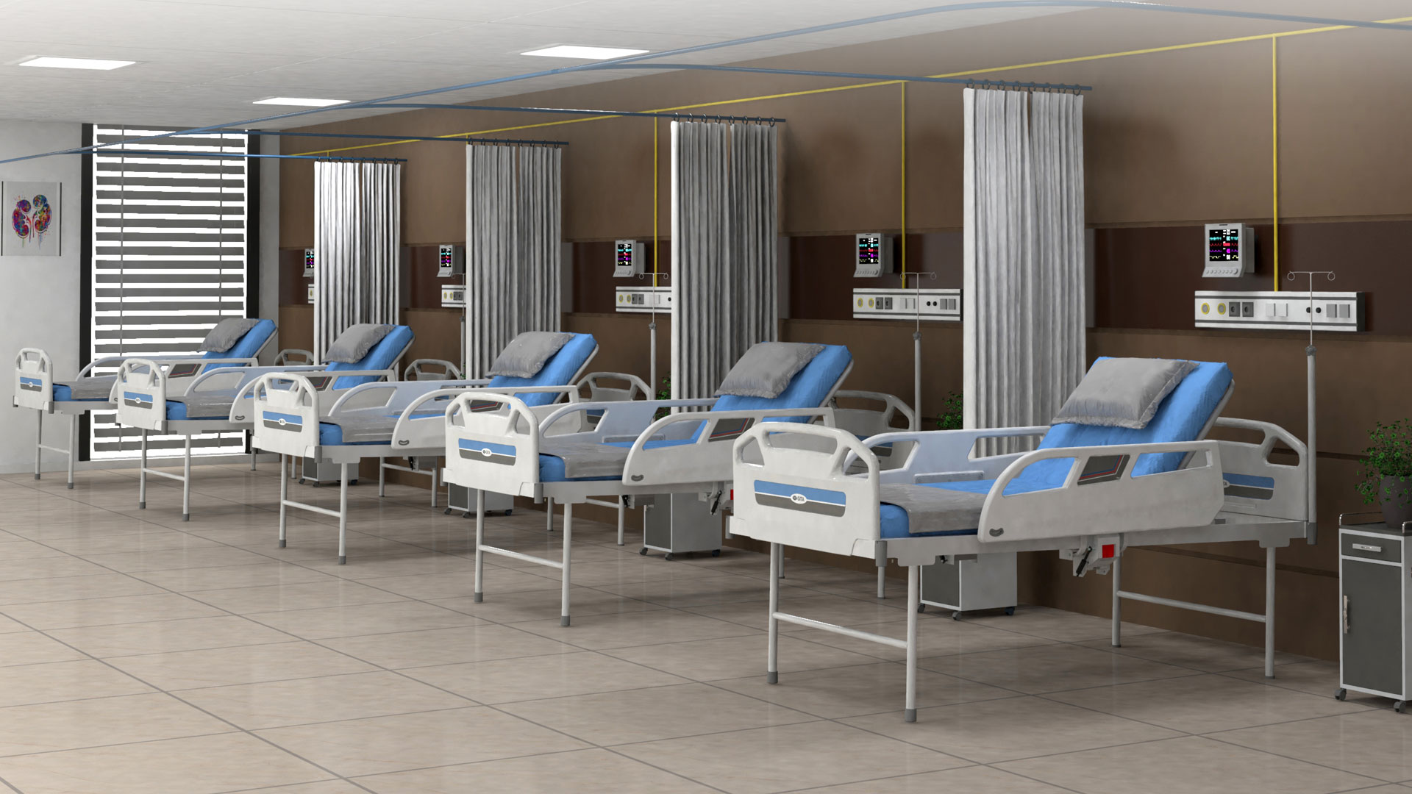
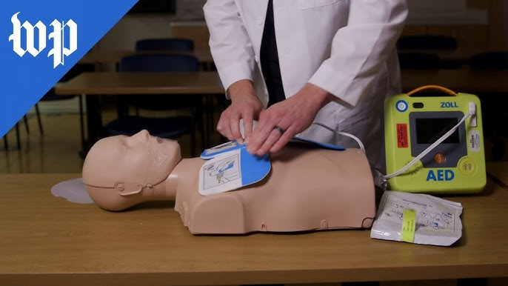
AI-Powered Smart Routing System
Enhancing Emergency Response with AI
Automated First-Aid Guidance
Provides real-time first-aid instructions for paramedics.
Hospital Bed Availability
Integrates with hospitals for real-time ICU bed status
Real-Time Traffic Data
Uses live traffic info for fastest ambulance routes.
Proactive Resource Allocation
AI predicts demand, ensuring efficient resource use.

Slide 5
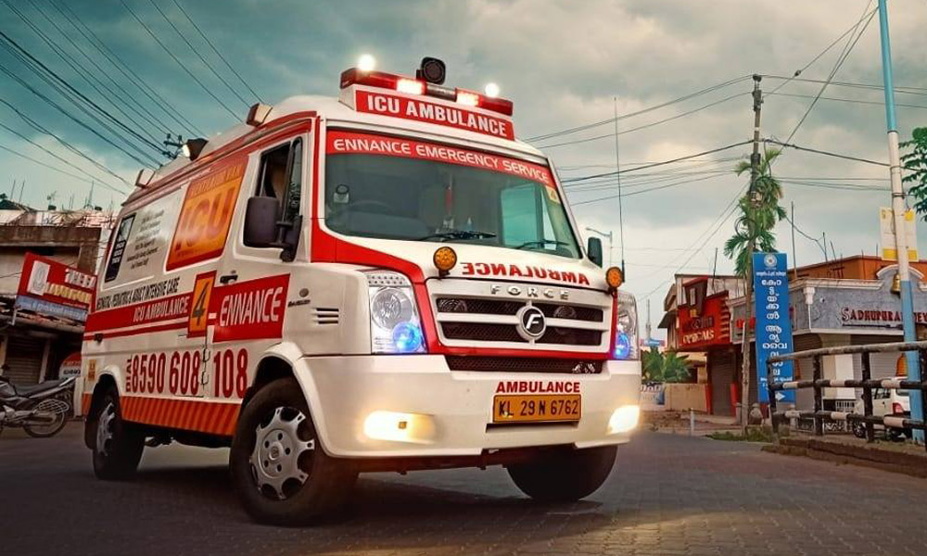
Innovations in Smart Ambulance Routing
Exploring cutting-edge solutions for emergency response
AI-Driven Hospital Readiness Prediction
Utilizes AI to forecast hospital capacity, enhancing patient transfer planning.
Automated Dispatch & GPS Tracking
Ensures efficient ambulance dispatching and real-time tracking during transit.
Smart Traffic Light Integration
Establishes ‘Green Corridors” to prioritize ambulances at intersections, minimizing delays.
Example of Impact
Singapore’s ‘Green Link’ initiative has reduced emergency response times by 40%.

Slide 6

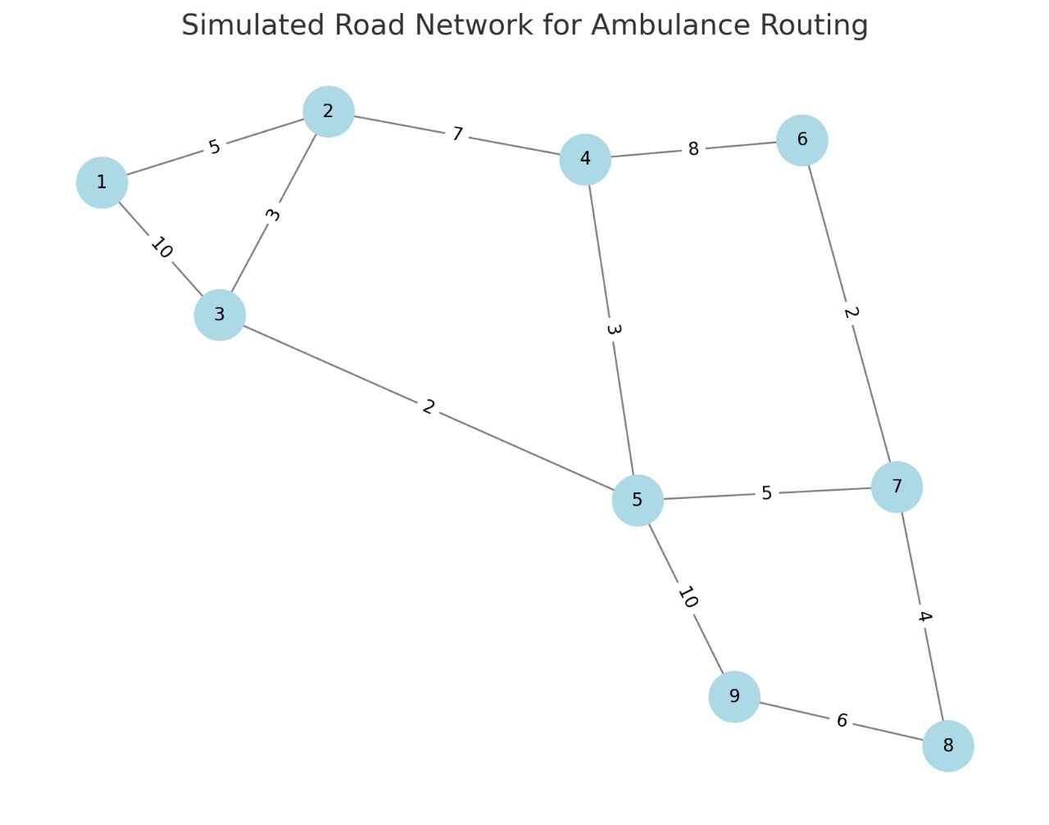
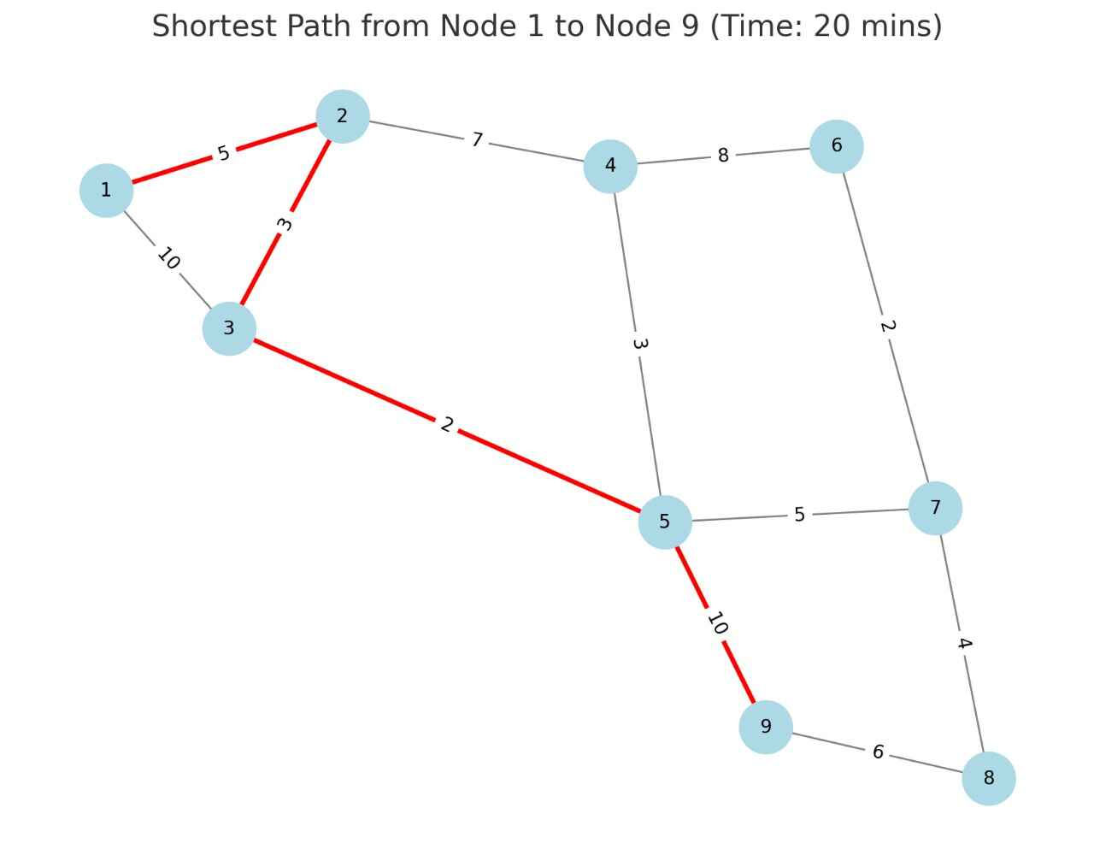
SHORTEST ROUTING APPROACH
Simulated Road Network
This graph represents the city's road network, where nodes symbolize key junctions or hospitals, and edges depict the roads connecting them. Each edge is labeled with a weight, representing the travel time or distance between locations. The graph structure allows the system to model real-world traffic conditions and optimize ambulance routes efficiently.

Slide 7
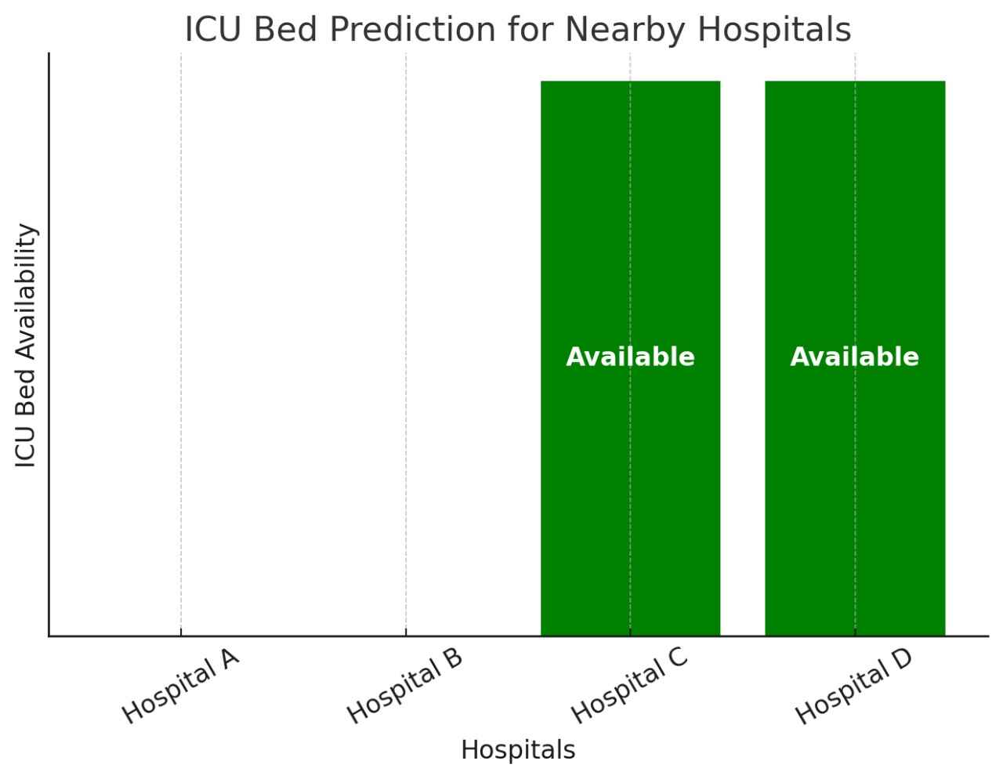
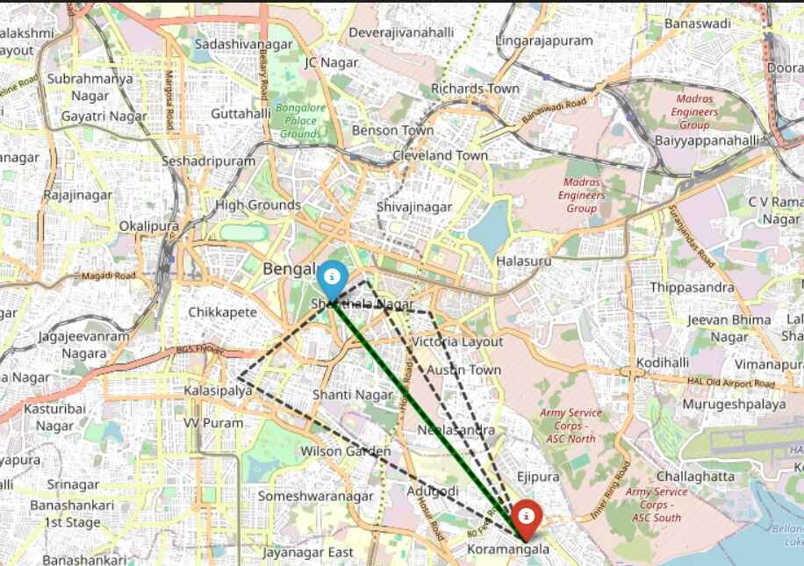
ICU Bed Prediction for Nearby Hospitals
This bar chart dynamically updates ICU bed availability across multiple hospitals.
✅Hospitals marked in green have available ICU beds, while those full are shown as blank.
✅The system continuously gathers data from hospital records, ensuring real-time decision-making for ambulances to transport patients to the most suitable medical facility.
✅This solution integrates graph theory, shortest path algorithms, and real-time data analytics to enhance emergency medical response efficiency.
Route Optimization on Real Map
This visualization showcases the AI-based ambulance routing system on a real-world map, generated using Folium. The map displays:
✅ Source (Blue Marker): The ambulance's starting location.
✅ Destination (Red Marker): The target hospital with available ICU beds.
✅ Optimized Route (Green Line): The shortest and fastest path dynamically calculated based on real-time traffic and hospital bed availability.
The system utilizes graph-based pathfinding algorithms to ensure quick emergency response by reducing travel time. This integration of GIS mapping and AI-driven routing enhances real-time decision-making for emergency medical services

Slide 8
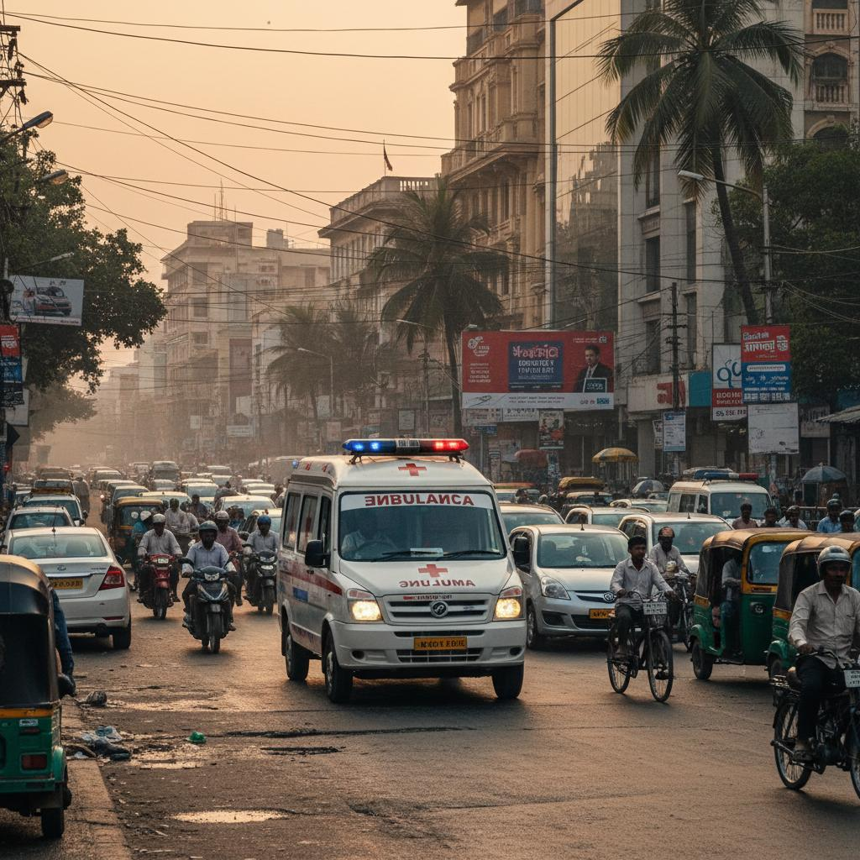
Why Efficient routing is Very Essential?
1. Time-Critical Emergency Response (Life-Saving Factor)
In ambulance routing, every second matters during emergencies like heart attacks, strokes, or accidents.
Efficient AI-driven routing ensures fastest paths considering traffic, roadblocks, and dynamic conditions, reducing response time.
In ICU bed prediction, timely identification and routing of patients to hospitals with available ICU beds avoids delays that could lead to critical deterioration or fatalities.
2. Optimal Resource Utilization (System Efficiency)
Ambulances and ICU beds are limited resources. Inefficient routing leads to congestion, resource wastage, and uneven load distribution across hospitals.
AI ensures smart allocation: directing ambulances to hospitals with available beds and predicting demand, thereby avoiding overcrowding in some facilities while others remain underutilized.
This not only saves more lives but also improves overall healthcare system efficiency and scalability.

Slide 9
Target Audience for AI Ambulance Systems
Identifying key users of AI Ambulance System
01
Primary Users
05
Government Bodies
Key stakeholders directly using the system.
Focus on improving emergency response strategies.
02
EMS Operators
06
General Public
Dispatch centers optimizing ambulance routes.
Overall community benefits from faster response times.
03
Paramedics & Drivers
07
Law Enforcement Authorities
Personnel relying on real-time navigation.
Assist with traffic clearance for ambulances.
04
Patients & Families
Urgent medical needs addressed more quickly.

Slide 10
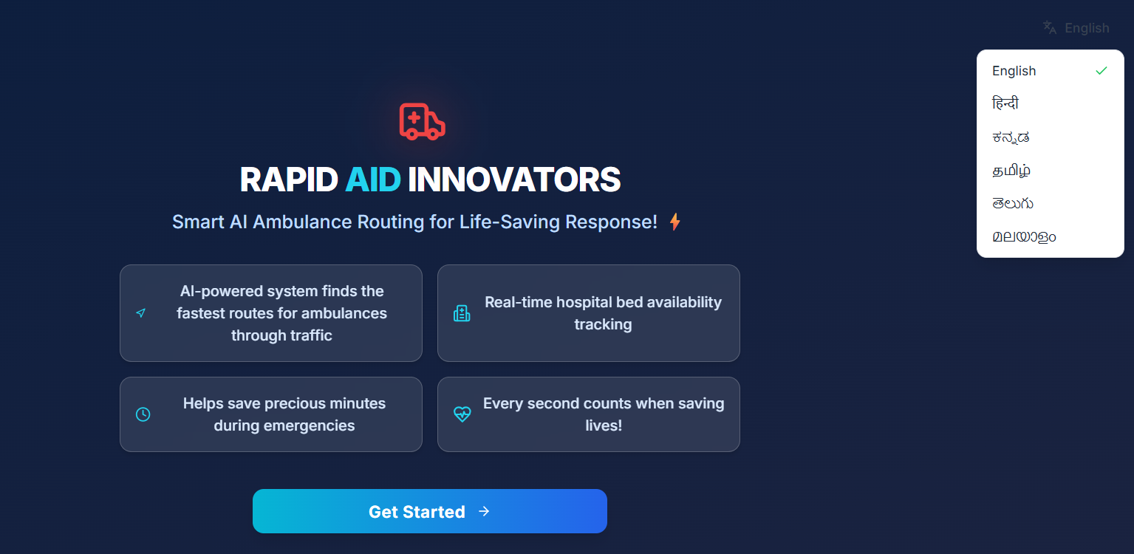
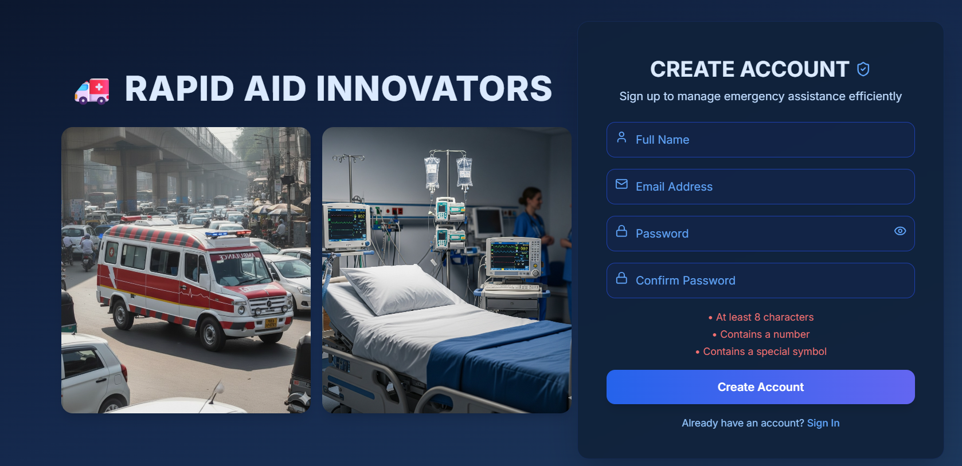
Our Solution
🔹 Phase 1: Get Started Page (Multilingual Intro Screen)
Novelty: Multilingual support (6 Indian languages) is a strong differentiator rarely seen in early prototypes of healthcare solutions. Makes it inclusive for patients, attendants, and emergency staff.
Creativity: Crisp tagline and iconography (ambulance + bed tracking). Good use of highlights like, icons for features.
Feasibility: Language translation is feasible but accurate medical terminology translation may be tricky (risk of miscommunication).
Scalability: Can be scaled to more languages & dialects, even voice-based commands for illiterate patients.
Limitations / Challenges:
Quality & accuracy of translations (medical terms often don’t have direct equivalents).
Maintaining real-time synchronization across all languages.
🔹 Phase 2: Authentication Page (Sign In / Sign Up)
Novelty: Standard feature but necessary. Novelty comes if you integrate hospital staff verification, emergency personnel accounts, or Aadhaar/health ID integration.
Creativity: Clean, modern UI with real ambulance and ICU imagery → creates contextual awareness. Password conditions shown upfront (user-friendly).
Feasibility: Easily implementable with standard authentication libraries (Firebase Auth, OAuth, etc.). Secure storage of patient/ICU data will be a regulatory compliance challenge (HIPAA, Indian NDHM guidelines).
Scalability: Can scale with role-based access (Patient, Ambulance Driver, Doctor, Hospital Admin).
Limitations / Challenges:
Cybersecurity (handling sensitive patient data).
Balancing ease of login (emergency speed) vs. security (multi-factor authentication).
Risk of network downtime during emergencies.

Slide 11
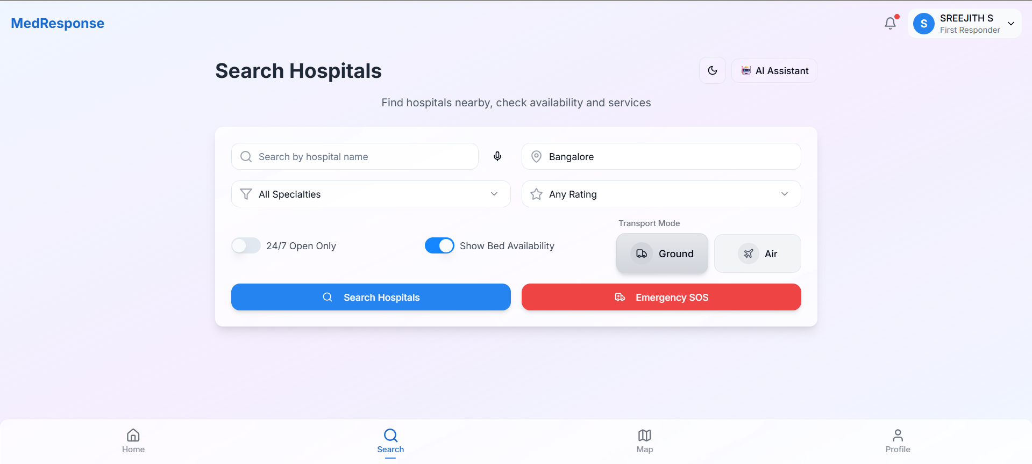
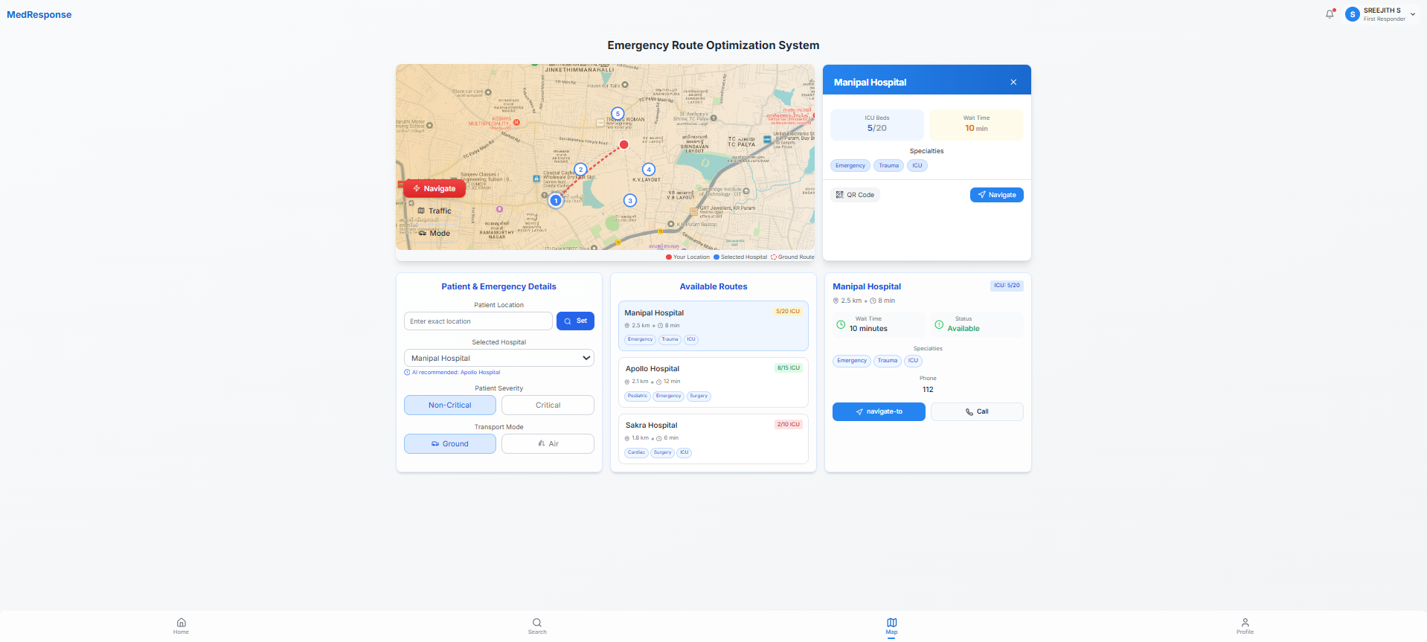
Our Solution
Phase 3: Dashboard (Hospital Availability + Mapping)
Novelty:
Very novel not just routing ambulances, but also predicting ICU bed availability in real time.
Combines live traffic, hospital data, and patient severity → unique integration.
Creativity:
Use of real-time analytics, survival rates, ICU occupancy, wait times, geographic incident heatmap.
Emergency alerts (traffic, power outage) = very practical.
Feasibility:
Technically challenging requires APIs for live traffic (Google Maps, MapMyIndia), hospital data feeds (HL7/FHIR standards), and accurate prediction models.
Hospitals may not always share real-time ICU data.
Scalability:
If proven, can scale across cities and integrate with national health mission dashboards.
Could also be extended to include air ambulances & rural health centers.
Limitations / Challenges:
Data availability many hospitals lack automated ICU bed reporting systems.
Prediction reliability AI model must avoid false positives/negatives (critical risk).
Integration with government health databases is a major bureaucratic challenge.

Slide 12
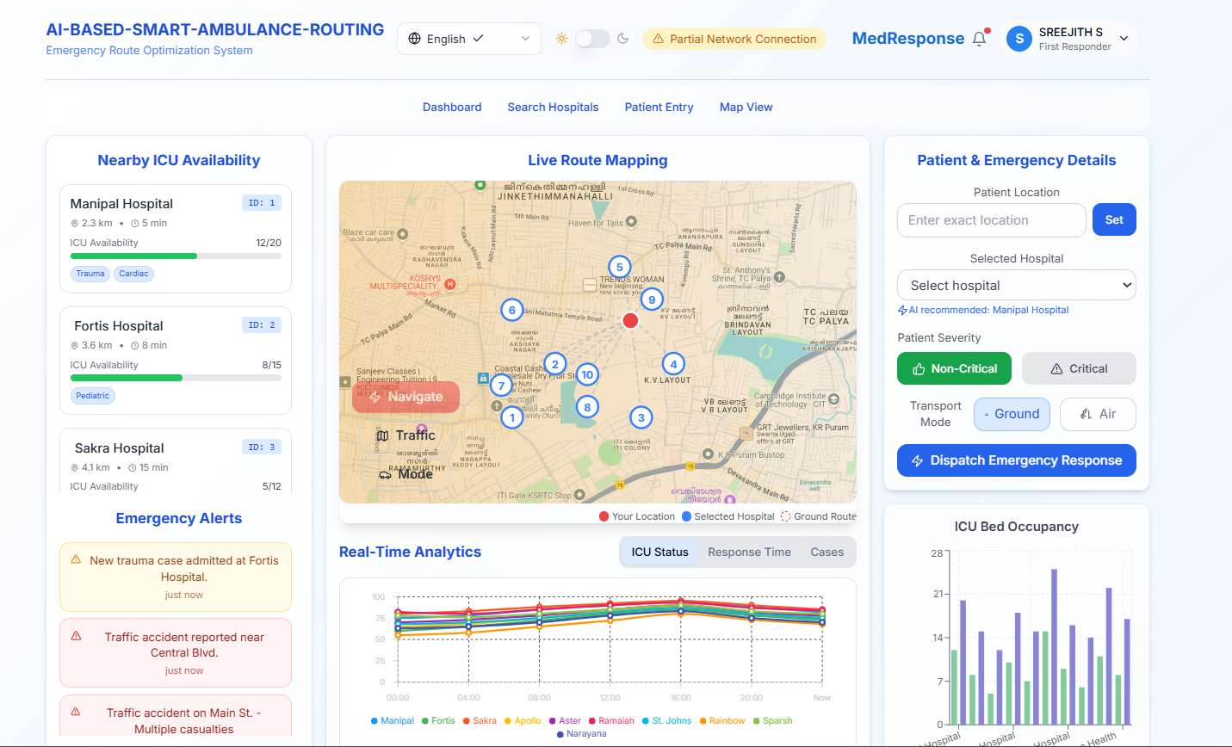
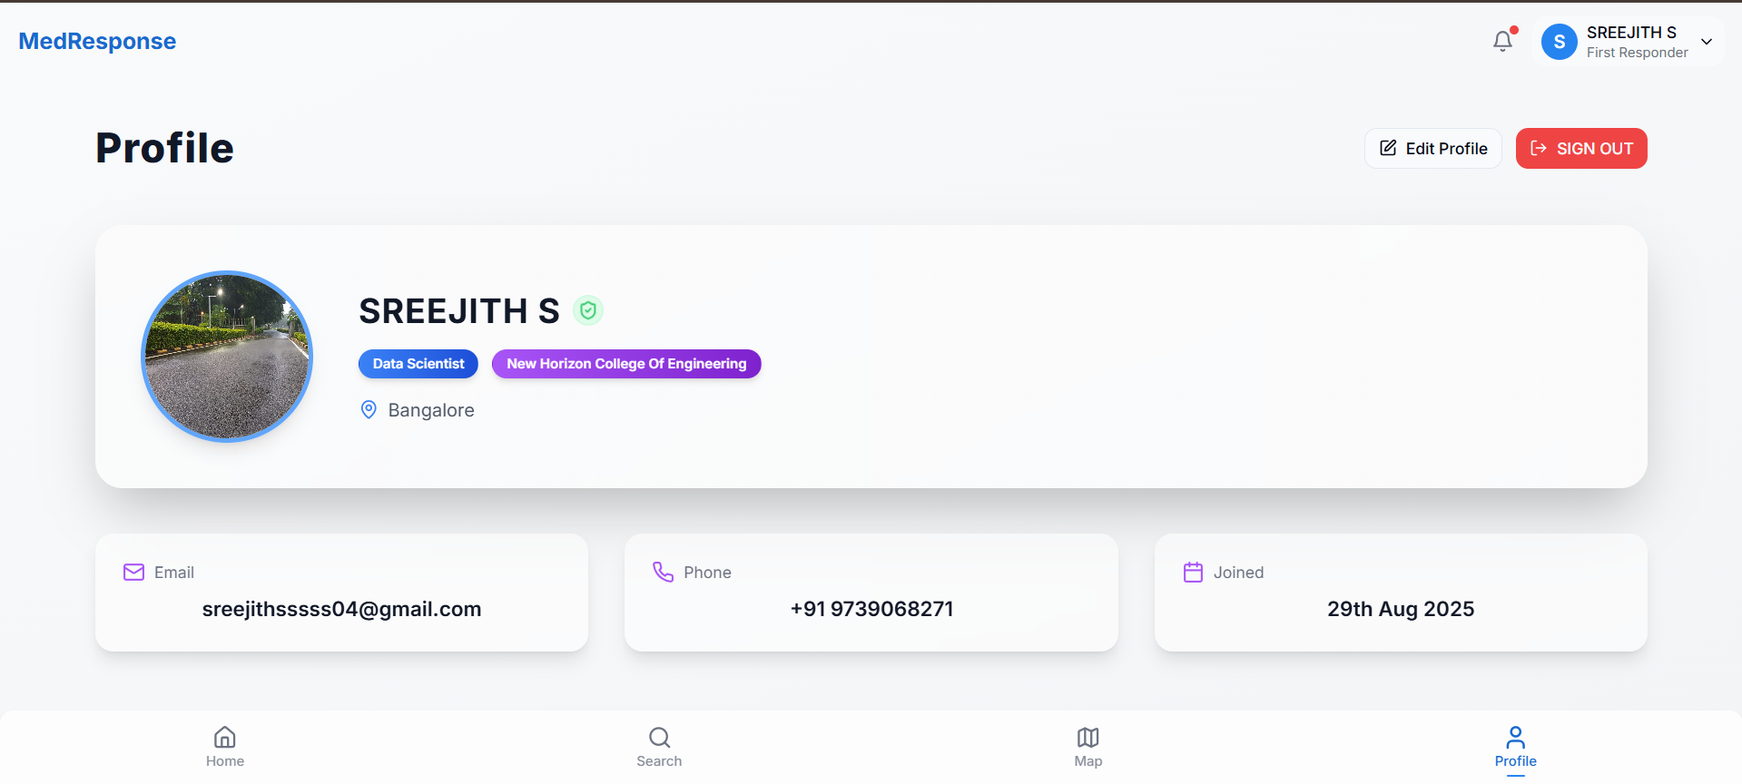
Our Solution
Phase 4: Profile & Role-Based Access (Hospital Staff / First Responders)
Novelty:
Professional role-based profile system (Hospital Staff, First Responder, Patient).
Verification badge + role tags make it reliable.
Creativity:
Neat card-based UI with role identity & affiliations.
"Data Scientist / College Affiliation" tags add authenticity (could be adapted for hospital roles).
Feasibility:
Easy to implement with existing user management systems.
Needs proper authentication (avoid fake responders).
Scalability:
Can integrate multi-level roles → Admin (hospital), Staff (ICU nurse), Responder (driver), Public (patients).
Could later integrate with Aadhaar/NDHM Health ID.
Limitations:
Sensitive personal info (phone, email, health data) must be stored securely (HIPAA, NDHM compliance).

Slide 13


